Slide 1

P.H.A.T.C.A.T.
Group 6
John DeFour, Daniel Hobbs, Ed Millet, & Brett Ross

Slide 2
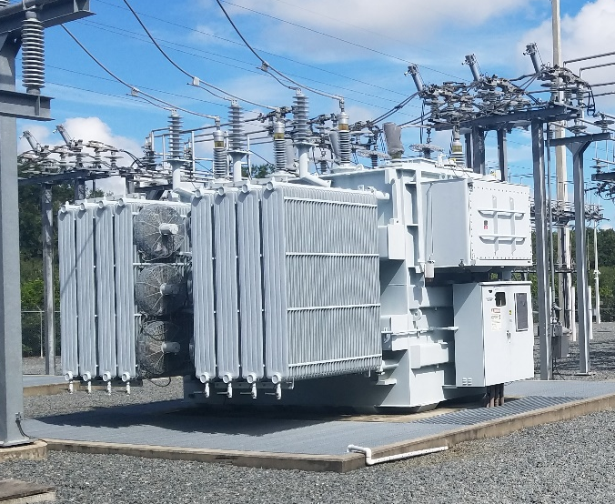
What is PHATCAT?
Phasor
Harmonic
Analysis for
Transformer
Condition
Assessment &
Telemetry

Slide 3
Wait What?
Power Transformers need Protection
In industry, ‘Microprocessor Relays’:
Read power system analogs
Signal Processing & Algorithms detect faults
Support system telemetry
Much more!

Slide 4
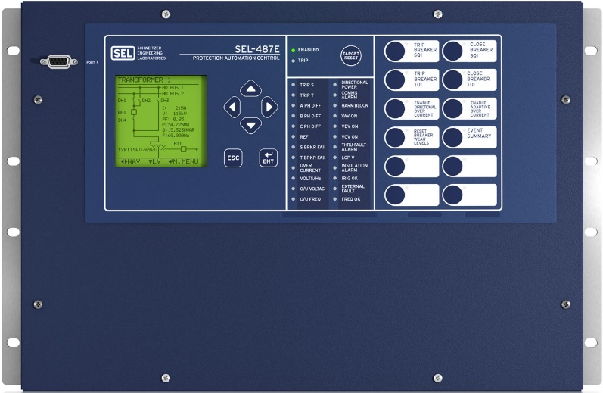
Why PHATCAT?
Some authors in this field
A variety of disciplines involved
Great need for education in this field

Slide 5
Objectives
Primary Goal: Detect Faults in the Grid
Differentiate between different kinds, take appropriate action
Support user Customization
Provide user information

Slide 6
Key Specifications
Function/Feature | Key Specification
Collects data to determine phasors | 5% Accuracy for phasors
Operation time | 2 Cycle Trip Time
Fundamental frequency tracking | Frequency range 45Hz-65Hz
Harmonic blocking | Measure up to 5th harmonic
Supports standard protection functions | Time Overcurrent, Restrained Differential, Overexcitation
Supports external 125VDC logic circuitry | Sense inputs and output contacts logic circuitry

Slide 7
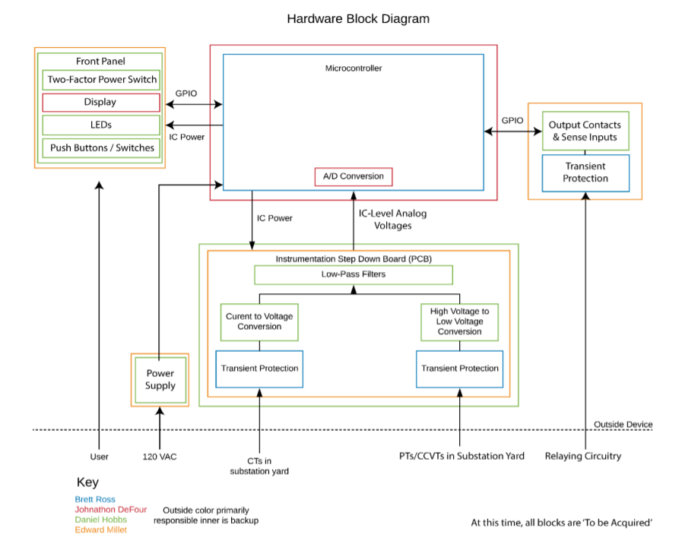
Hardware Functional Block Diagram
Front panel with LCD display for information and LED push buttons for interaction.
Off the shelf power supply
Instrumentation step down board with analog inputs
Output contacts and sense inputs
ADC conversion and MCU
Notes:
-LCD for user interaction, programmable push buttons defined by users needs (opening/closing contacts) & power switch for turning on PHATCAT
-analog instrumentation board to step down current and voltages to a manageable levels for the MCU and circuit board components
-Contacts & sense inputs to be controlled by the MCU have programmed logic to users needs. E.g to take out the corresponding line out of service OR alarm sound.
-ADC to provide digital outputs from the instrumentation board to the MCU for analysis

Slide 8
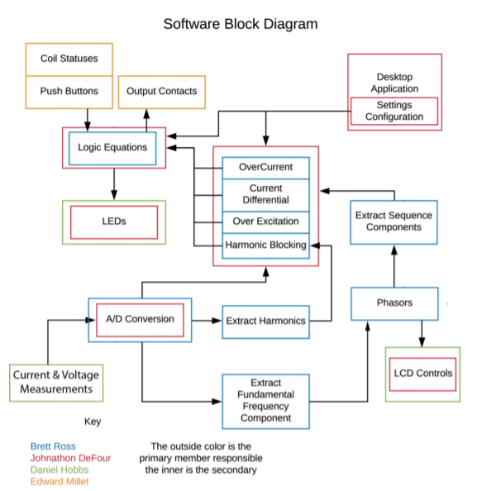
Software Functional Block Diagram
Analog inputs from current and voltage transformers.
A/D conversion for software analysis
Extracting the fundamental frequency
Constructing phasors & displaying them
Logic equations set by user from the desktop application
LEDs will be programmable with a cheat-sheet to translate the link between the LED and status it represents (coil status, faults etc.)
Notes:
Start with current and voltage measurements
Lead into ADC
Extracting harmonics and fundamental
Lead into phasors and sequence components
Lead into protection algorithm block (mention LEDs that are #’d )
Lead into logic equations being changed via desktop application
LED’s light up according to logic and the status of the coils, push buttons, output contacts

Slide 9
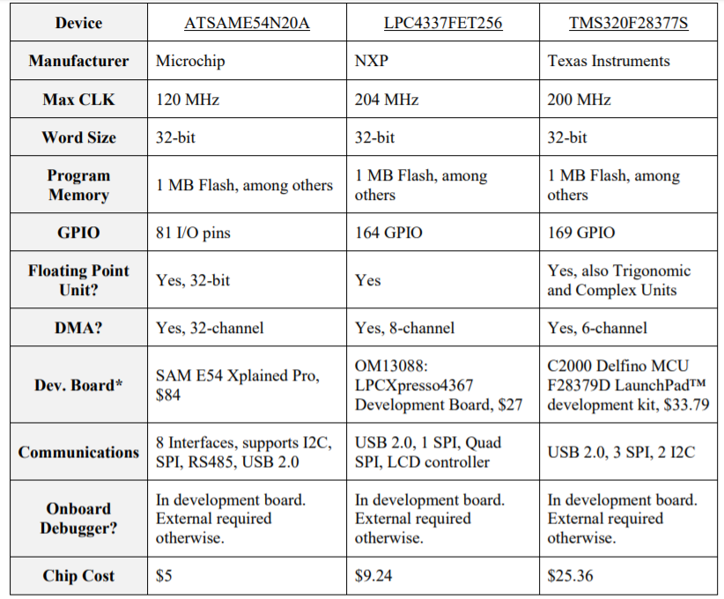
Microcontroller Selection
C28X processor provides specialized cases for trig functions & complex numbers (TMU & VCU) which will be used for phasor analysis.
Development board comparatively affordable price & has JTAG for debugging.
Online documentation of the development CAD layout for reference.
Existing application guides for signal processing
Notes:
-the TMS320F has a C28X processor which provides dedicated software for complex & trig functions along with floating point which will key for constructing and manipulating the phasors extracted from the inputs.
-dual processor allows delegation of priorities for mission-sensitive objectives such as protection algorithms.
-TI provided a .brd file for Eagle which provides a 6 layer board layout which can and will be used as resource when designing the final PCB layout.
-JTAG for debugging is also included in the design which is crucial for the MCU and allowing for debugging to be done without removal of the chip.

Slide 10
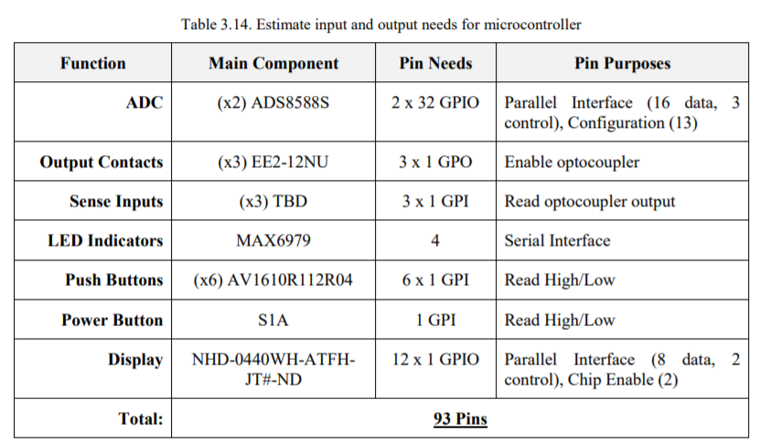
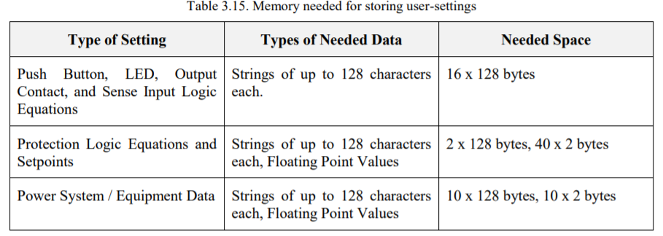
Microcontroller Selection
Minimal 16-bit word size to accompany the external ADC
At least 93 GPIO pins required to preform all the tasks required
Support via TI E2E forums
We chose the MCU after the hardware selection since there are so many choices.
Notes:
DMA will be used as a work around so that the latency due to interrupts can be avoided. DMA will allow for the values supplied via communications be stored directly in the MCU memory without interrupts.

Slide 11
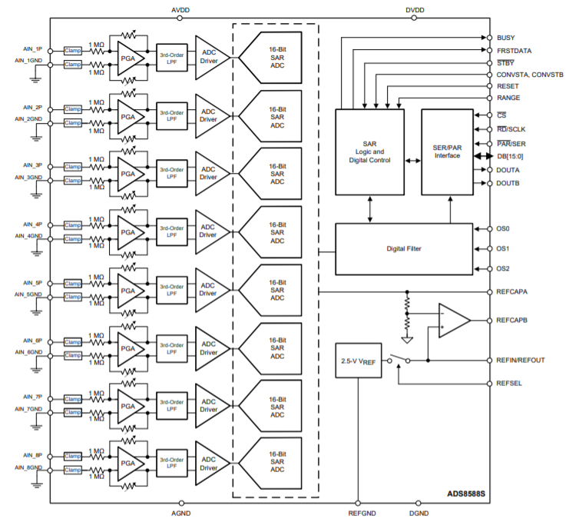
16 Bit Analog-to-Digital Convertor
Maximum 200kSPS
Offers a programmable gain amplifier for improved accuracy over wide range
Internal 3rd order lowpass Butterworth antialiasing filter
Controllable Oversampling
Bipolar inputs
Differential inputs
True simultaneous sampling
Notes:
-the ADC has a single rail power supply but allows for a bipolar inputs
-Differential input allows for the signal to be immune to common noise by measuring the difference between the two input signals to the alternative of having a common ground.
-PGA used to Changes the internal gain of the ADC to keep the input signal in the most accurate range to provide an optimal signal to the MCU
-16 bit output allows for high resolution signal to be created to ensure the data such as magnitude, phase and power, is precise
-Able to be paralleled with other ADS8588s IC’s to allow for more then 8 channel inputs
-uni-polar vs bipolar inputs
Internal ADC
-only 8 channels with differential inputs
-only a 2.5 volt reference external is ±10
-lower SNR then external
-uni-polar input

Slide 12
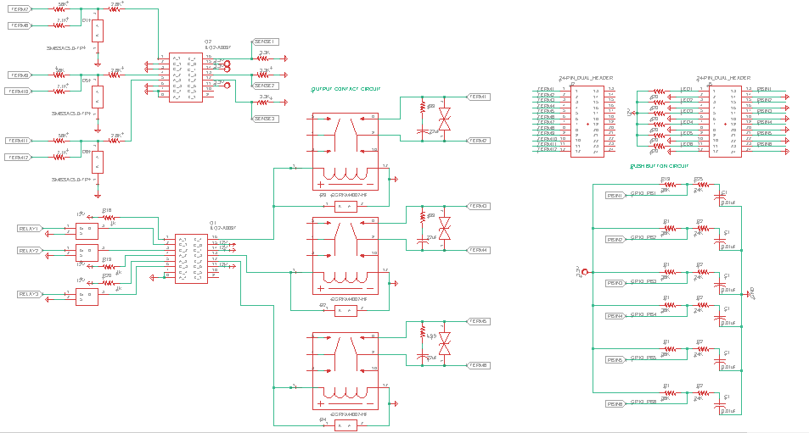
PCB Schematics
Connectors/PB LEDs
Sense Inputs
Push
Buttons
Output Contacts
Notes:
Here are the schematics that were designed in Eagle: The Sense Inputs, Output Contacts, Connectors/PB LEDs, and Push Buttons

Slide 13
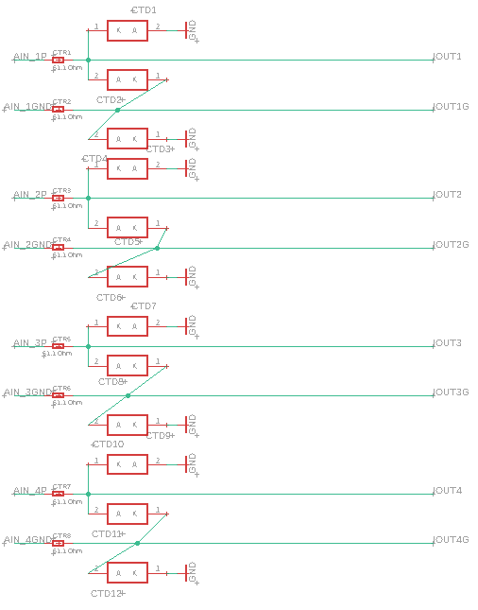
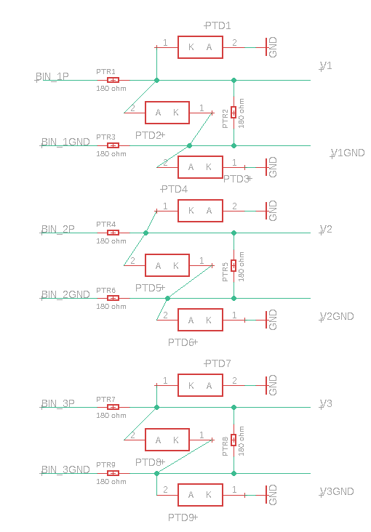
PCB Schematics Cont.
Current Sensing
Voltage Sensing
Notes:
Additionally our 8 Current Sensing Circuits and 6 Voltage Sensing Circuits

Slide 14
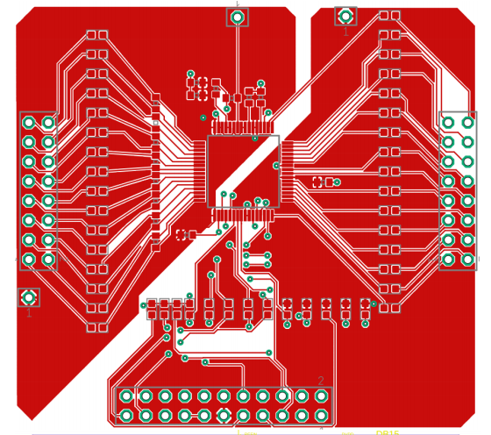
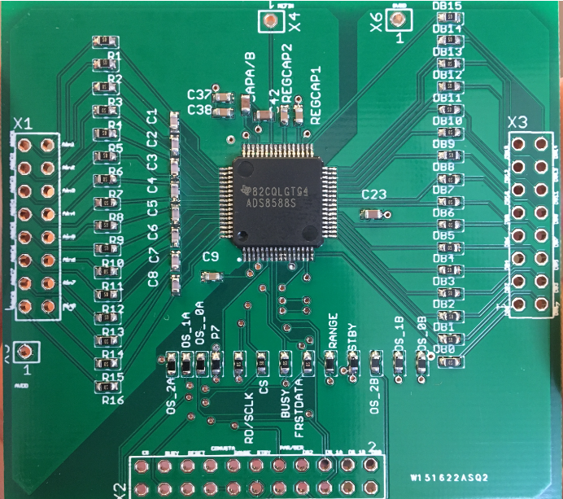
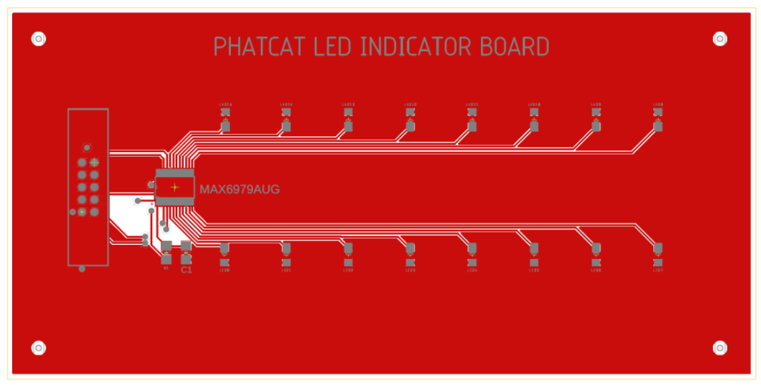
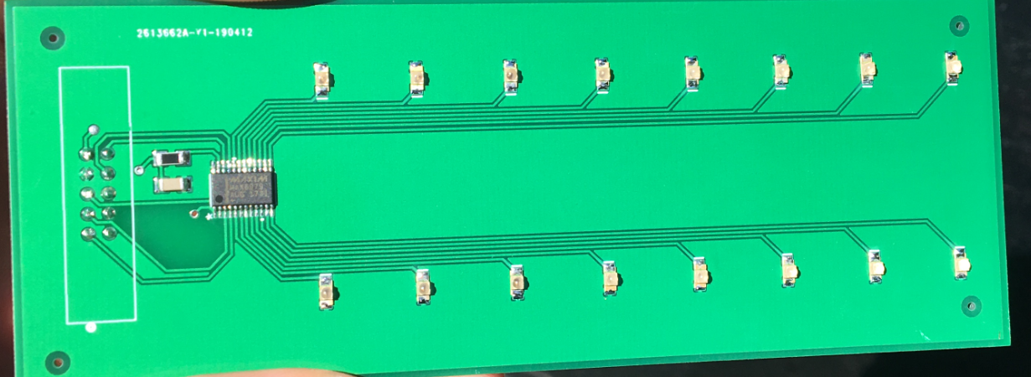
PCB Board Layout
62mm
A/DC
BREAK-OUT BOARD
57mm
LED INDICATOR BOARD
2”
5.25”
Notes:
Here are a couple board layouts that have already been designed and tested. The LED Indicator Board and A/DC Breakout board. The A/DC breakout board was needed to get the ball rolling with the software side of things.

Slide 15
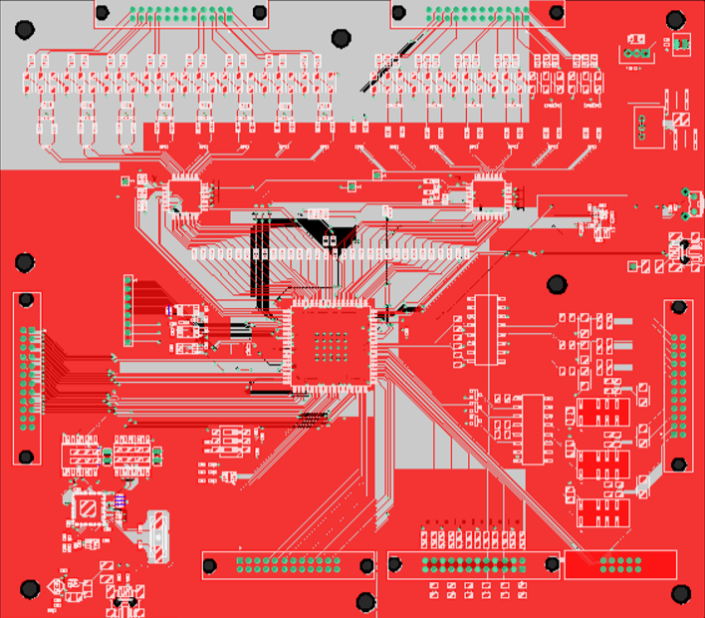
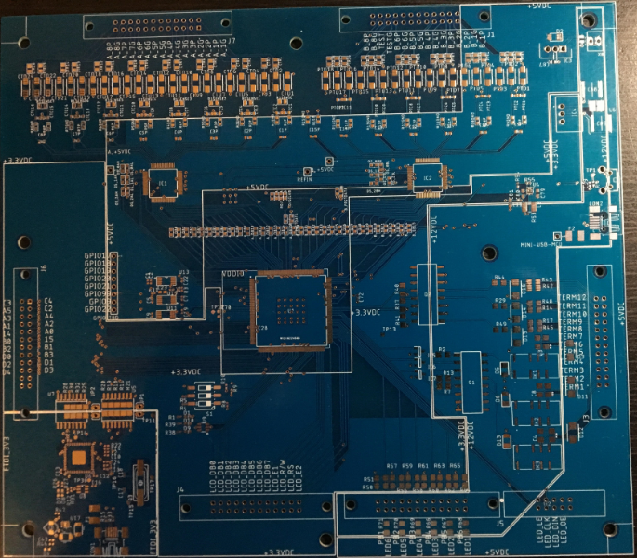
PCB Board Layout Cont.
MAIN BOARD
181mm
205mm
Notes:
Finally the Mainboard Design that was sent out for manufacturing and assembly recently with over 200+ components on the board including a 176 pin MCU Chip and two 60 pin A/DC IC Chips.

Slide 16
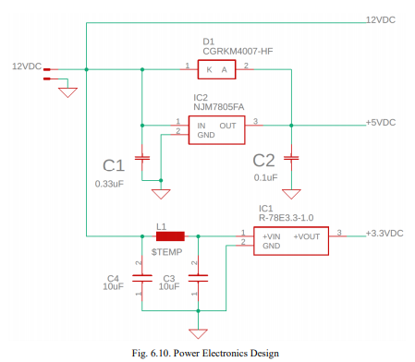
Power Electronics
NJM7805FA
R-78E3.3-1.0
Major Component Voltage Requirements:
Push Buttons, Relays – 12V
LED Driver – 5V
MCU – 3.3V
Input
5V Regulator
Outputs
3.3V Regulator
Notes:
Next, I will talk to you a little bit about the Power Electronics of PHATCAT. The purpose of the Power electronics is to provide power to the PHATCAT Relay and all of its components. In determining what these power requirements are the major components voltage level and power ratings are considered. Here you can see that our pushbuttons and relays require 12V. The LED Driver requires 5V and the MCU requires 3.3V. You can see the Schematic created in Eagle on the left side of the screen. In yellow we have our 12V input coming from our power switch located on the front of PHATCAT. From their connecting to our 2 voltage regulators of 5V and 3.3V, outputting the desired voltage levels we need.

Slide 17
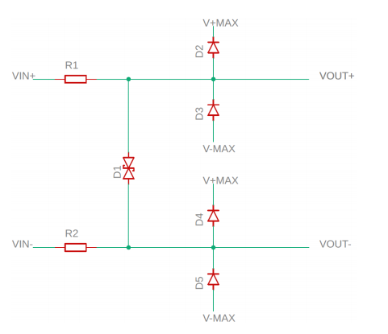
Transient Protection
Purpose:
To protect electronic circuit components from ESD and Transients.
Features:
TVS Diode (D1)
4-DIODES (D2,D3,D4, & D5)
2-RESISTOR (R1 & R2)
Differential Mode
Protection
Common Mode Protection
Notes:
Transient Protection measures were taken in regard to our current sensing, voltage sensing , sense inputs and output contact circuits. A TVS diode was added to provide protection against a potential difference between the plus and minus inputs. In case of a common voltage that is too high where the TVS diode will not operate because the difference between the two will be zero, common mode protection was added from each input to ground. The 2 resistors will help control the amount of current seen in the circuit.
D1 is a bi-directional TVS diode that is chosen to limit Vout + - Vout - to below the absolute maximum rating of the protected circuit
However, it is feasible that there may be a large common-mode input voltage, in which case D1 will not turn on.
D2 and D4 protect Vout + and Vout - respectively by limiting them to V+MAX + VD. D3 and D5 function similarly, instead providing the lower bound. R1 and R2 limit the current flowing through the diodes during an overvoltage.

Slide 18
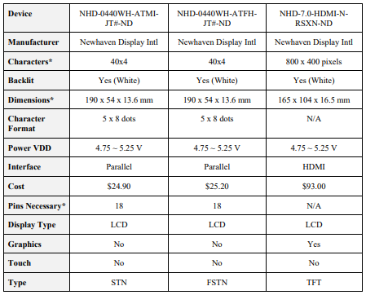
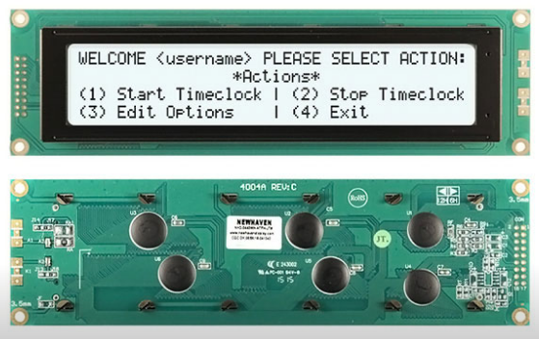
LCD Display
NHD-0440WH-ATFH-JT#-ND
Purpose: Display information
Features:
Simple Display
Low Cost
FSTN Model
Notes:
One of the major features of PHATCAT is the LCD Display. The purpose of the display is to show the calculated phase angles of the transformer. Three different models were considered. The type of LCD Display chosen is listed at the top of the slide and is a simple display with no graphics or touch capabilities and low cost. The model is the FSTN model which has the best contrast and most colors with the worst refresh rate, but will meet our needs.
The NHD-0440WH-ATFH-JT#-ND is a character and numeric only display that is a decent size and has enhanced contrast and viewing due to FSTN. Making the cost considerably lower than the more advanced graphics displays. For the characters, we need and the budget we have all of the displays will require 18 pins. Making us unable to use less than 18 pins for a simple to use character display. This display will fit our needs.
There are two types of displays that can be used in embedded systems. The character and numeric only display that can display a set amount of character on screen and nothing else. These displays are usually monochromatic and will have segments that can be turned on or off to show characters and numbers as needed. These require much less power electrically and computationally to operate. Making them ideal for portable battery powered devices. There are then the more advanced screens that have a resolution and behave like small monitors. They operate by activating pixels the screen that can be used to display a range of colors. Making it possible to display video and animations as well as more advanced graphics on the screen. These displays require much more power electrically and computationally to operate and special connections to connect to the microcontroller. Making these displays better for always plugged in devices that want to display a wide arrange of graphics to the viewer.
There are general character LCD that can come in three different formats: FSTN, STN, and TN. TN stands for Twisted Nematic and is the cheapest option, having lower contrast and fewer colors available. The refresh rate is the fastest of the three. Super Twisted Nematic has more contrast and a slower refresh rate. Finally, Film compensated Super Twisted Nematic has the best contrast and most colors but the worst refresh rate of all. (focuslcs).

Slide 19
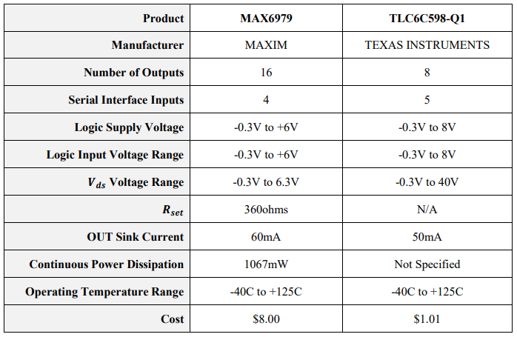
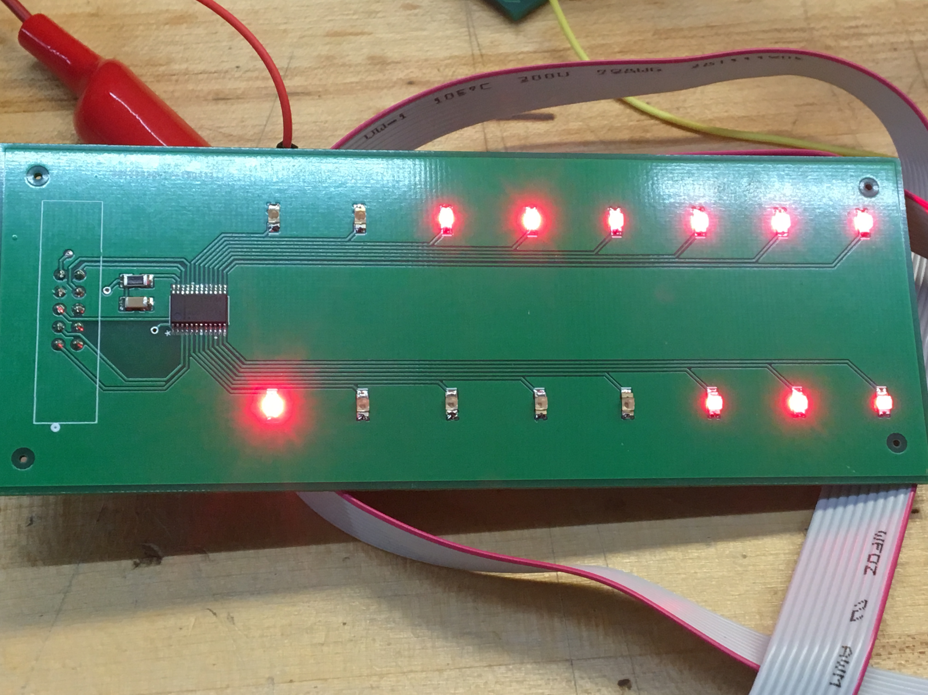
LED Indicator Board
MAX6979
Purpose: To indicate specific data and functions of PHATCAT
4 Serial Interface Inputs
16 Outputs
1- R_SET Resistor needed only
Notes:
Next, we will talk about PHATCAT’s LED Indicator Board. There initially was a total of 14 required LEDs, but we chose to add 2 more. We looked into a couple models of LED Drivers to drive our LEDs with constant current sinking. The purpose of the LED Drivers is to minimize the number of pins required from the microcontroller. The model chosen is listed at the top of the slide and was chosen because with one chip we can drive 16 LEDs where as the chip by TI would require two chips cascaded together. Additionally only one Rset resistor is required to drive the 16 LEDs and would only require 4 serial inputs where as TI required 5. In the picture below is a picture of the board being tested and working.

Slide 20
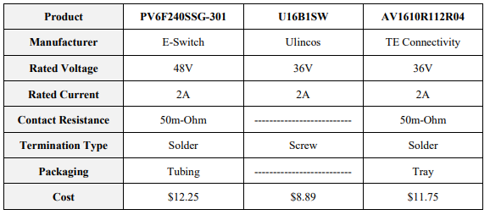
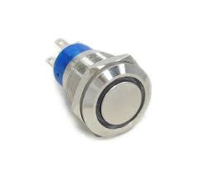
Momentary Push Buttons
AV1610R112R04
Purpose: To provide user programmable buttons for device versatility.
Fun fact: They look pretty awesome, but D*** are they expensive!
Notes:
Moving on, we have our push buttons located on the front of PHATCAT. The purpose is to provide 6 user programmable push buttons making the device more versatile. Fun fact: The push buttons look nice, but damn are they expensive. The reasoning behind choosing the push buttons was to improve the cosmetics of PHATCAT and thought that it would add a nice visual by wiring up the LED Ring at the center of the Push Button to be energized continuously. Three different models were considered and the one chosen is listed at the top of the slide. The reason why this model was selected was due having a more prominent manufacturer with great documentation on top of it.

Slide 21
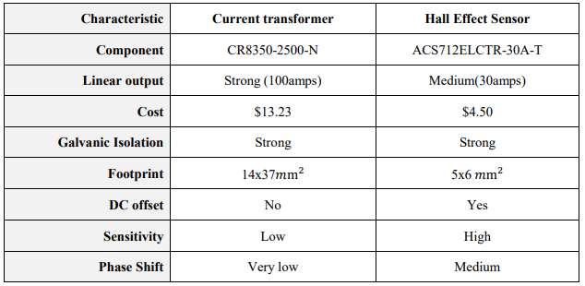
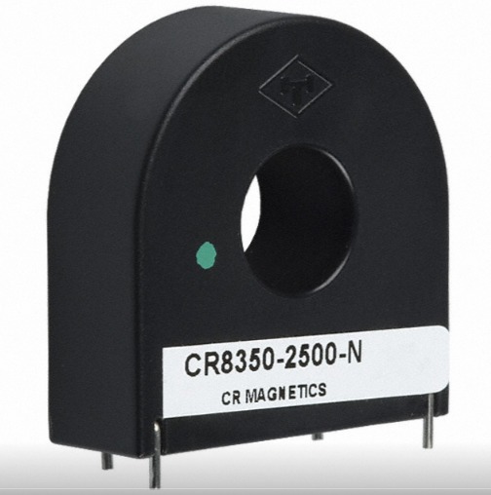
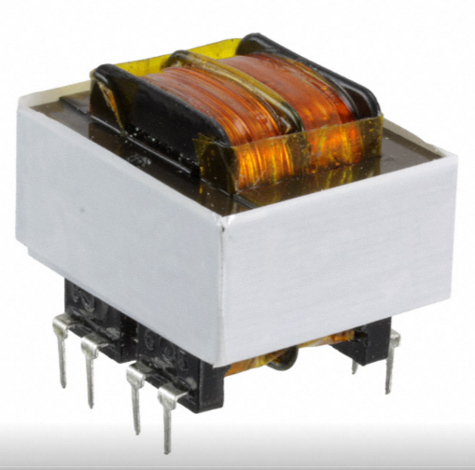
Current & Voltage Sensing
CR8350-2500-N
F20-055-C2
8-Current Transformers:
2500:1 Ratio
Higher Saturation Level
Longer Linear Output
Minimal Phase Shift
6-Potential Transformers:
Voltage Primary – 115V
Voltage Secondary- Parallel 10V
Notes:
Next, we have our current and voltage sensing, where current transformers and potential transformers were selected to step down the current and voltage inputs to an acceptable level. For example, the Current Transformer with a 2500:1 ration will take in 30 A and output 12mA and the Potential Transformer will take in 115V and output 10V with an 11.5:1 ratio. Initially before selecting the current transformer a Hall Effect Sensor was considered. The Current Transformer was selected due to it having no DC offset, Low Sensitivity, and very little phase shift as these characteristics are very important for future calculations.
Inputs and Measurement - 8 rear-panel inputs for analog current measurement.
o They must have a continuous thermal rating of at least 5A RMS
o They must accurately sense currents up to at least 30A RMS
o They must have a one-second thermal rating of at least 30A RMS
o They must have an effective series resistance (ESR) of less than 100 mOhm.
When a current is sent through a semiconductor, a continuous flow of current is passed through the material [3.3]. Once placed inside a magnetic field, the flux deflects the charge carriers known as electrons and holes [3.4]. Reference figure 3.18 for a diagram visualization of how this effect is seen. As these charge carriers separate, a potential difference is produced across the semiconductor. The voltage measured across the plate is called the Hall Voltage and is proportional to the magnetic field perpendicular 25 to the device. The voltage is typically in the range of a few millivolts even with a strong magnetic field. Typically, an op-amp is used to improve the signal strength and sensitivity of the device
6 rear-panel inputs for analog voltage measurements.
o They must have a continuous rating of at least 67 volts RMS
o They must have an ESR of at least 1 kOhm.
After discussing the desire of the components in this design along with the advantages and disadvantages, the current transformer has been selected for the following reasons. A linear output is a major desire where the voltage from the sense resistor will need to follow a proportionate to the current flowing through it. As seen from table 3.3, the cost of a CT does run a bit higher than that of the hall sensor, but it comes with its valuable trade off. The phase is going to be an important factor in monitoring the signal and the magnitude of the harmonics.

Slide 22
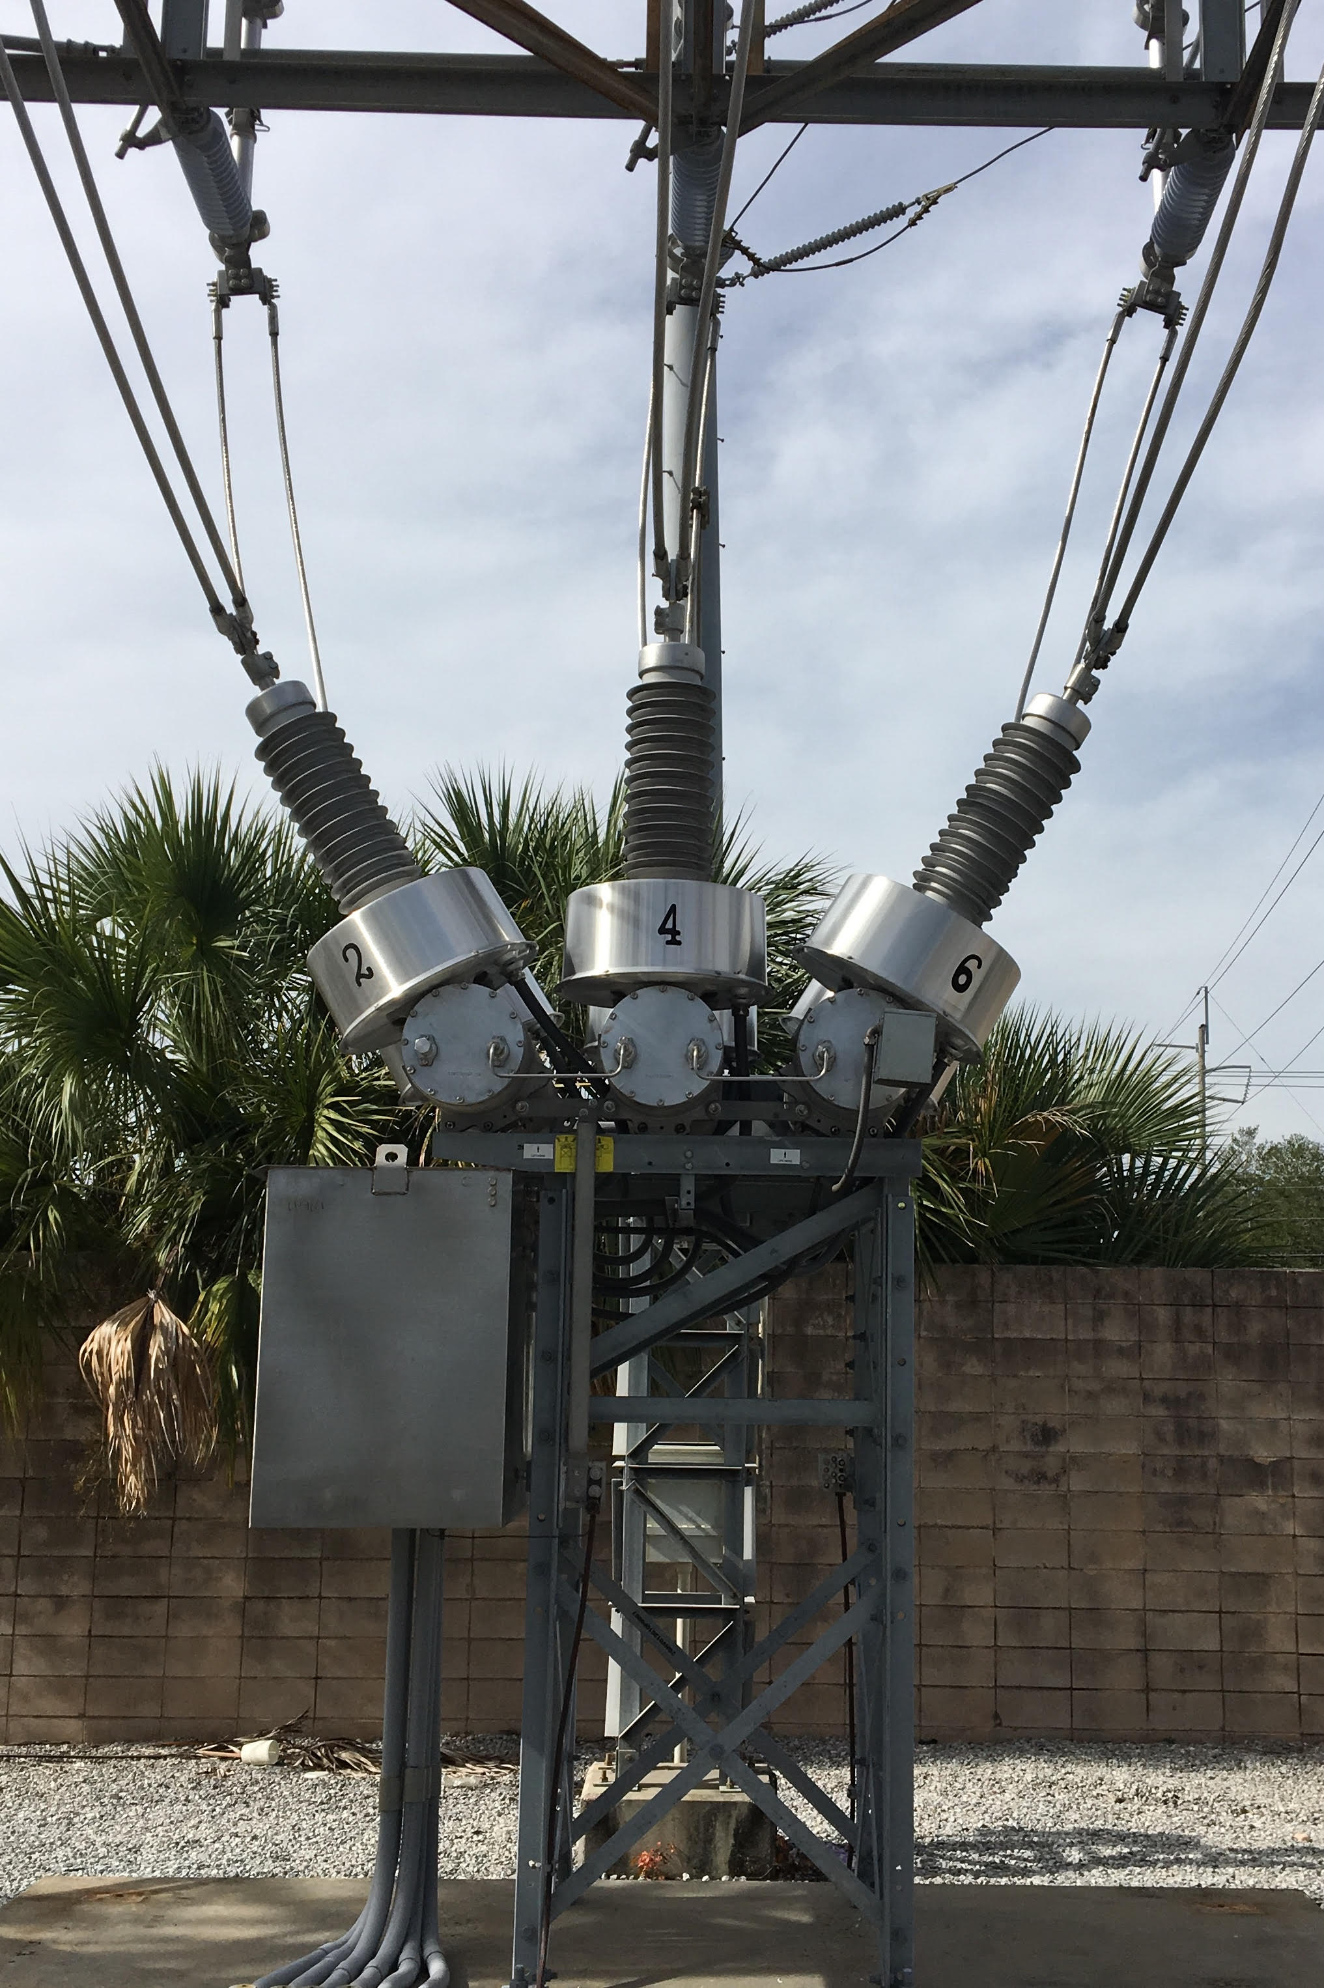
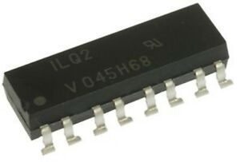
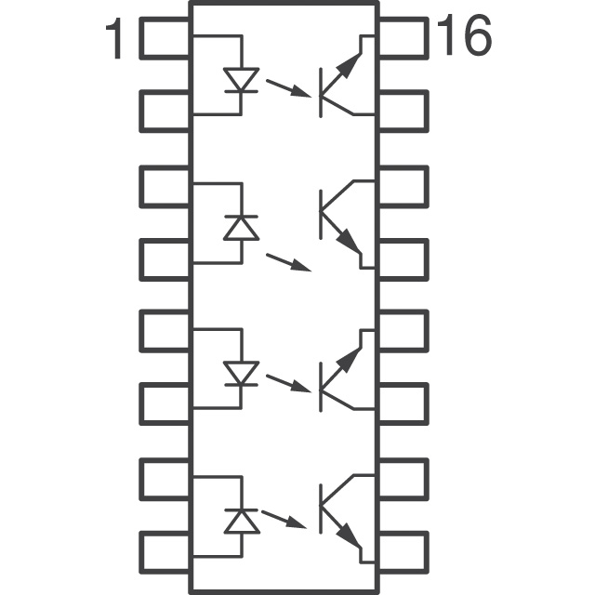
Sense Inputs
ILQ2
Purpose: To monitor equipment status in the Substation.
Features:
Read 125VDC Input Signal
Reduce Voltage Signal
Isolate Input Signal
Notes:
Sense Inputs: The purpose of the sense inputs is to monitor equipment in the substation. For example, monitoring the gas level of a gas breaker as seen in this picture here. When the gas level gets too low, a contact will close energizing 125VDC input signal to PHATCAT at which point protective algorithms will activate accordingly sounding an alarm for a maintenance crew member to come fill it. In this circuit, the voltage was reduced using a larger resistor capable of dissipating more heat, a little more than a ¼ of a watt. A nice and necessary measure taken for both our sense inputs and output contacts was to isolate them using the Optoisolator ILQ2 model by Vishay, which essentially uses IR Diode to switch on a phototransistor with a certain amount of light intensity.

Slide 23
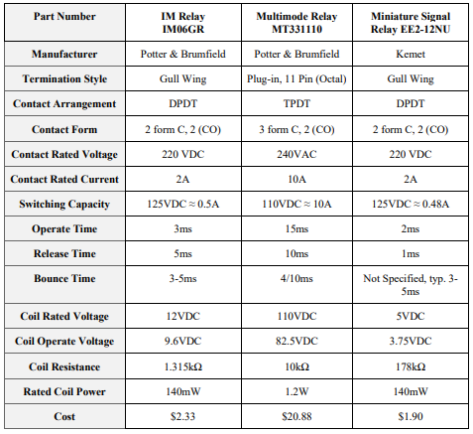
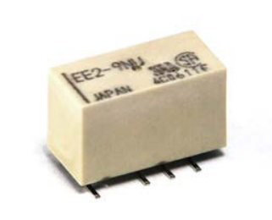
Output Contacts
EE2-12NUH-L
Purpose: To output low voltage signal for Primary circuit to energize Secondary Circuit.
Features:
Faster Operating Time
Lower breaking capacity
Low Cost
Notes:
The purpose of the output contact circuit is to apply a low voltage signal to switch on or off a much larger electric circuit. For example, PHATCAT sees a Transformer fault, therefore, a differential protection will operate, sending a signal to our output contact circuit, which operates a relay that energizes a breaker coil, opening breakers on both sides of the transformer, isolating the fault and preventing the equipment from being damaged. Three different relays were considered and the model we chose is listed at the top of the slide. Initially, we were trying to break 10A of load, but the cost and speed of the relay went up dramatically which is why we chose the relay we did only costing $1.90 vs $20 and an operating time of 2ms vs 15ms.

Slide 24
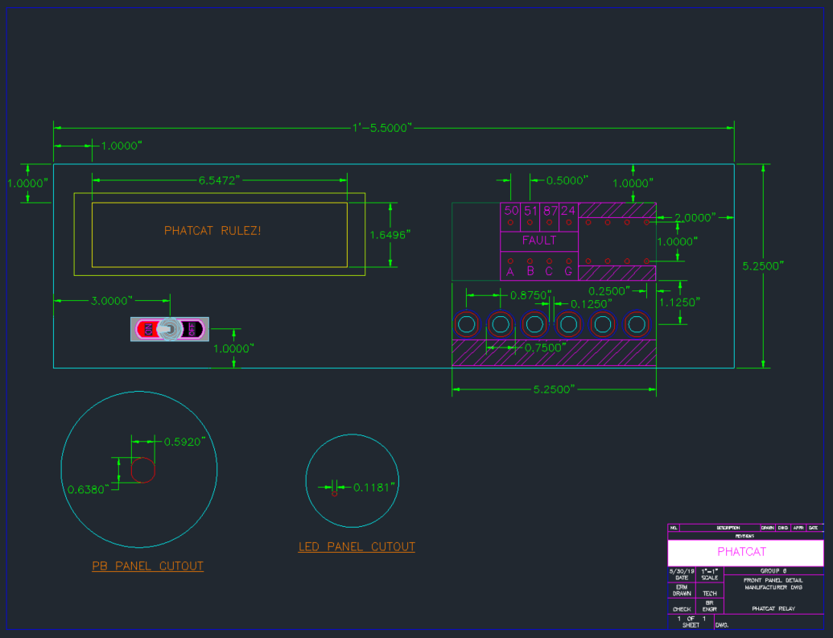
AutoCAD Front Panel Draft

Slide 25
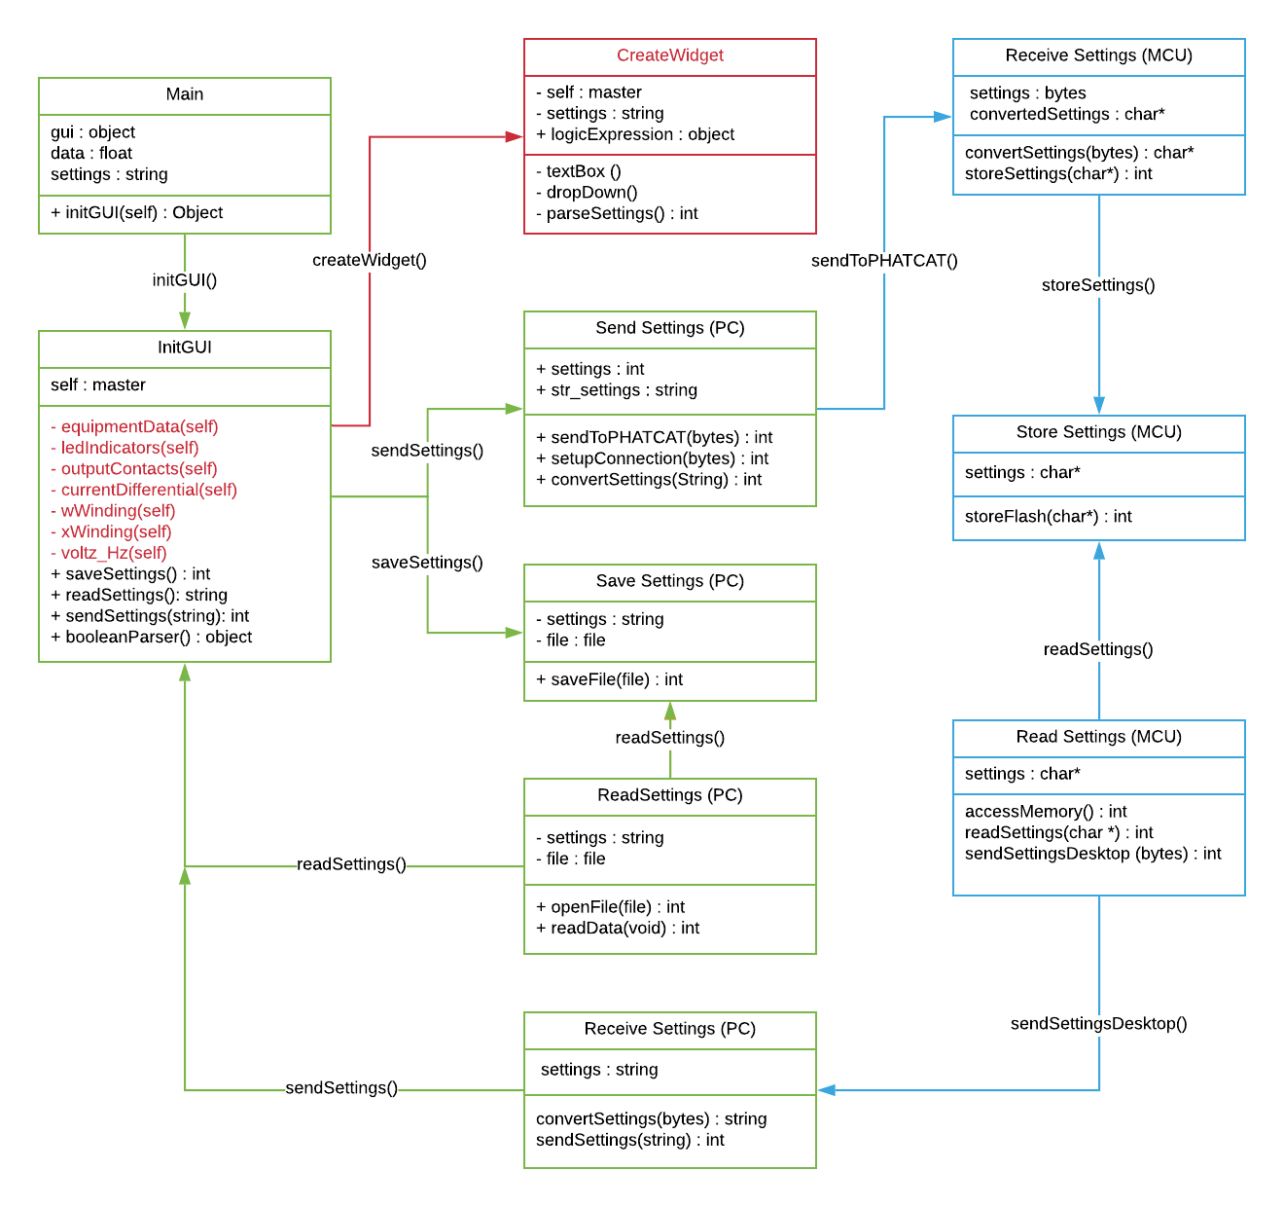
Desktop Class Diagram
Notes:
Finally the Mainboard Design that was sent out for manufacturing and assembly recently with over 200+ components on the board including a 176 pin MCU Chip and two 60 pin A/DC IC Chips.

Slide 26
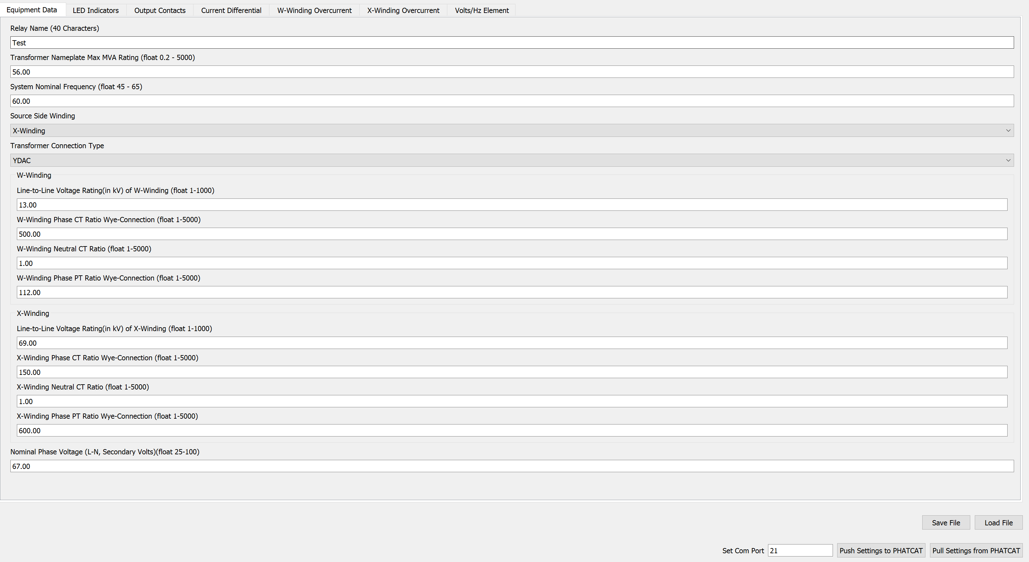
Desktop Application
User facing component
Used to relay settings to device
User can customize various options that can be sent to PHATCAT to alter how it behaves

Slide 27
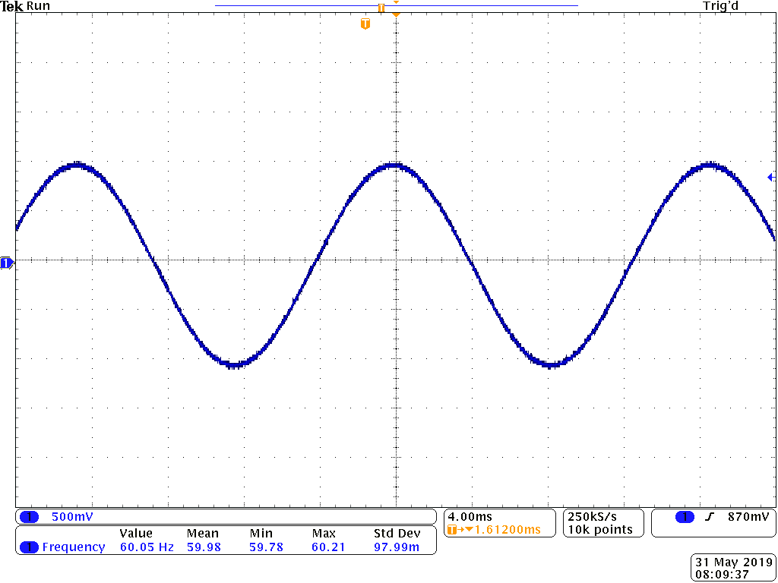
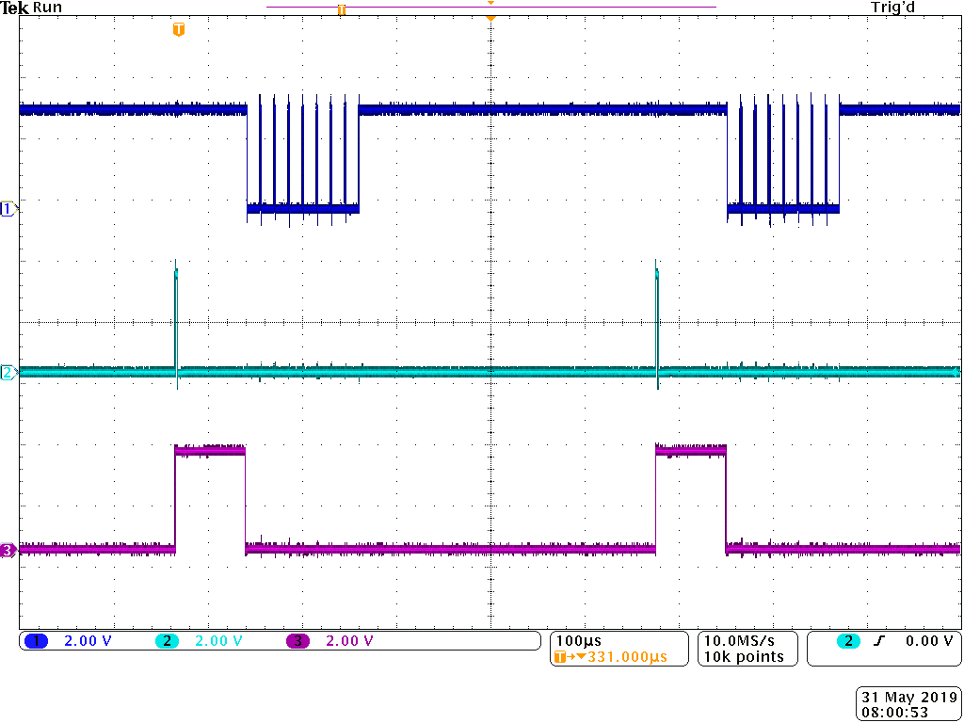
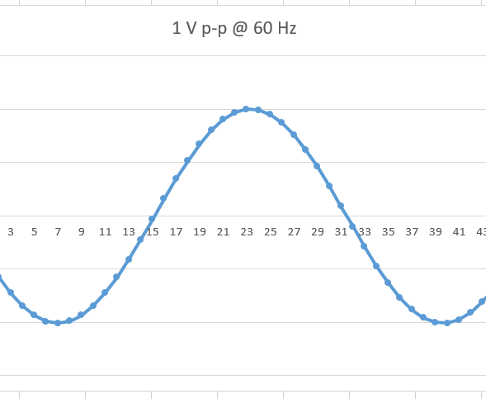
Analog to Digital Conversion (ADC)

Slide 28
Challenge: Accurate Data Fast
Need to act quickly, but FFT requires a window
Should see 5, 4, 3, 2, 1

Slide 29
Solution: Dynamic Sampling Time
Use ZCD Frequency to perform concurrent sampling
Single cycle fit gives consistent binning

Slide 30
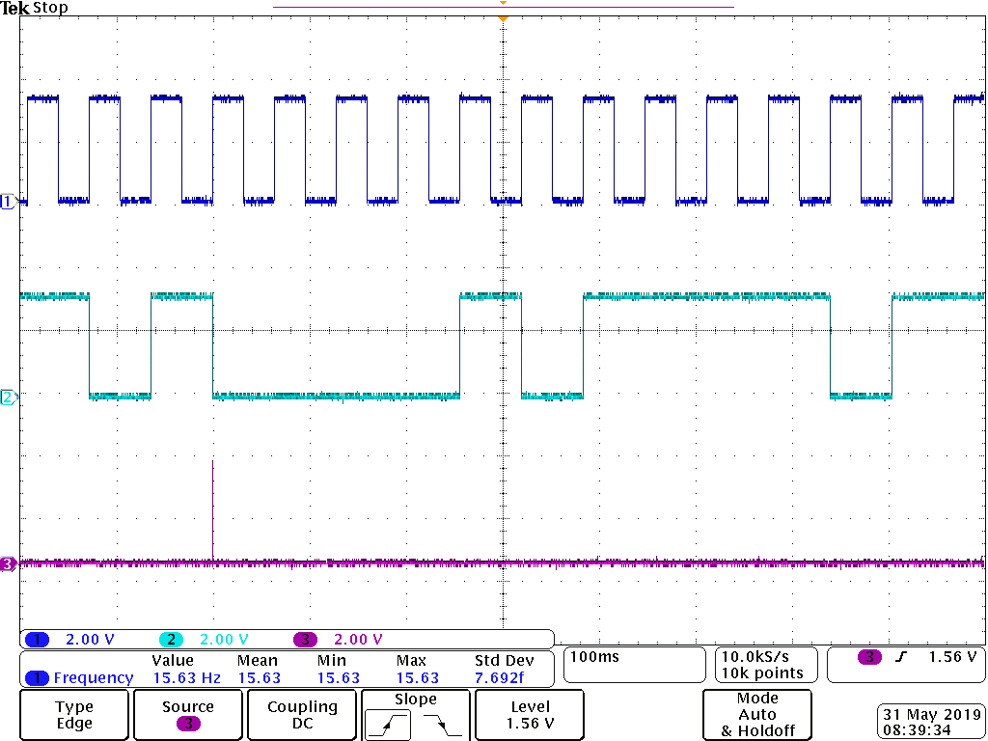
LED Communication
Used to know notify user what is happening with PHATCAT
Can be programmed to serve many purposes

Slide 31
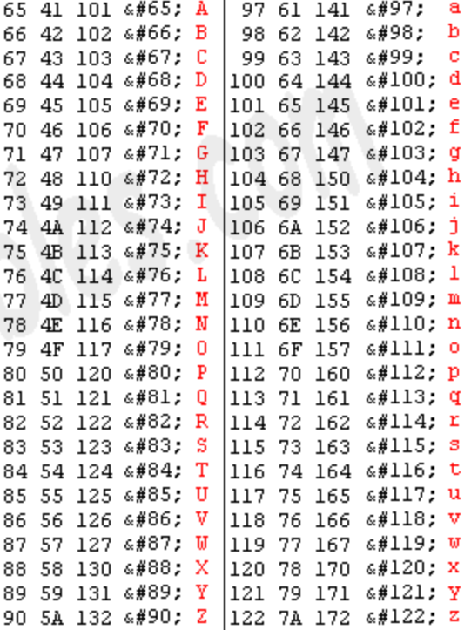
UART Communication
Connection between PHATCAT and PC
Clock and Baud rate very important
Send Data in bytes and translate at both ends

Slide 32
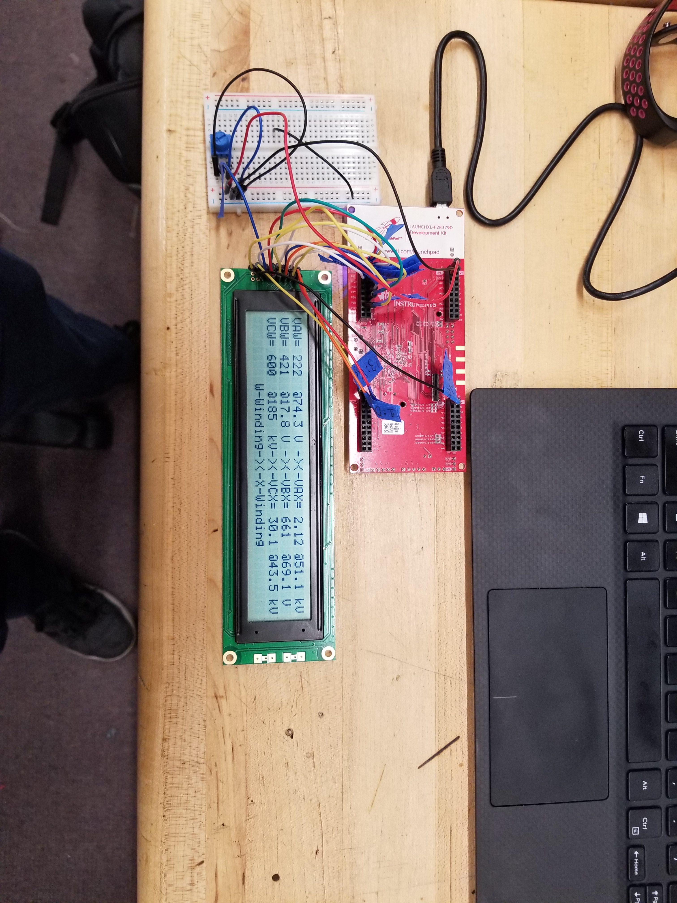
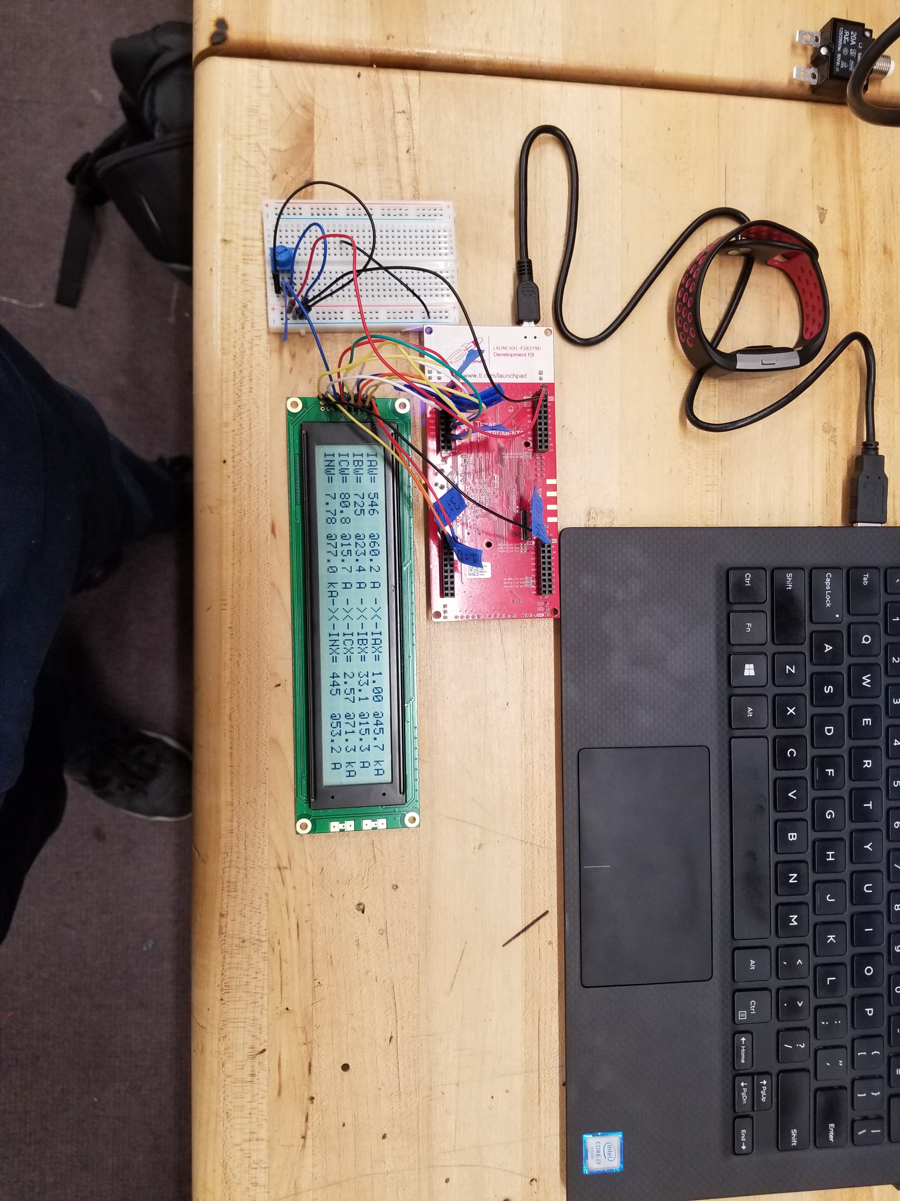
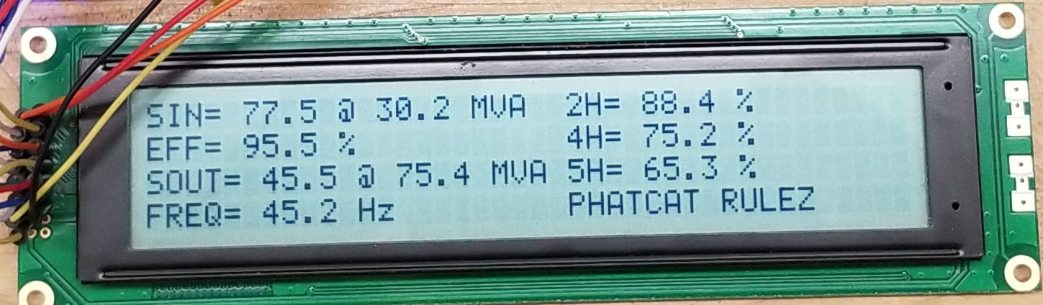
Liquid Crystal Display (LCD)
Visualize what's happening with PHATCAT
Will display Voltages, Currents, Power, Harmonics and Frequency

Slide 33
Responsibility
Brett:
MCU
ADC (HW + SW)
Transient Protection
Signal Processing
Protective Algorithms
Power Electronics
Display
Desktop App
Logic Equations
QA - all
John:
Desktop App
Settings Configuration
LEDs (SW)
Display
Logic Equations
MCU
Signal Processing
Support HW Testing
Protective Algorithms
Ed:
Output Contacts
Sense Inputs
LED PCB
Pushbuttons
Final Assembly
Materials
Main PCB
Power Electronics
Analog Front End
LEDs (SW)
Dan:
Analog Front-End
ADC Breakout PCB
Main PCB
MAIN PCB!
Enclosure
I/O, Buttons, etc.
Final Assembly
ADC
Transient Protection

Slide 34
Budget
Feature | Quantity | Expected Unit Cost | Expected Total | Actual total | Notes
Enclosure | 1 | $50.00 | $50.00 | $115.35 | Hardware, screw terminals, etc.
Display | 1 | $25.00 | $25.00 | $75.54
Power Switching | 1 | $15.00 | $15.00 | $25.71 | Buttons, cables, etc.
Development Board | 2 | $120.00 | $240.00 | $114.25 | x2 to parallel design processes
Front Panel LEDs | 20 | $0.30 | $10.00 | $18.38 | Extra for drivers needed
Front Panel Switches | 5 | .00 | $25.00 | $135.76
PCB Fabrication | N/A | $250.00 | $250.00 | $380.96 | Considers multiple iterations
Microcontroller | 2 | $20.00 | $40.00 | $50.72 | Chip only.
Power Supply | 1 | $30.00 | $30.00 | $9.55 | Considers extra converters
Current Sensing | 10 | $15.00 | $150.00 | $165.34
Voltage Sensing | 10 | $1.00 | $10.00 | $48.36
Board Protections | 1 | $50.00 | $50.00 | $37.81 | Used throughout board.
Output Contacts | 3 | $20.00 | $60.00 | $9.50
EMI Shields | 10 | $0.25 | $2.50 | None
Soldering Wire | 2 | $3.50 | $7.00 | $47.68
Sense Inputs | 5 | $1.00 | $5.00 | $23.78
Misc. Components | N/A | $20.00 | $20.00 | $301.31 | Resistors, capacitors, diodes, etc.
ADC/DSP | 2 | $30.00 | $60.00 | FREE
Total expected cost |  |  | $1049.50 | $1760.80

Slide 35
Acknowledgments
Dr. Chung Yong Chan
Rack Solutions
Duke Energy
Dr. Samuel Richie
Dr. Aleksandar Dimitrovski
Quality Manufacturing Services
Dr. Michael McAlpin

Slide 36
Questions? Comments?

